Slide 1

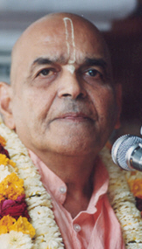
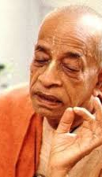
ध्रुव महाराज Dhruva Maharaj
Based on Bhagavat Saptah Lecture by HH Maha Vishnu Goswami Maharaj in Sydney

Slide 2
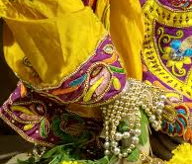
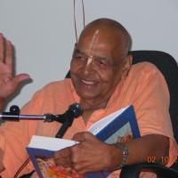
Recap
Duty in this age
Lead simple life
Don’t waste time in mental concoction
Utilize time in serious study of Bhagavatam
Medicine for this age
Hear, Study and Contemplate
Heart is meant for Krishna
Solution to our dissatisfaction
Spirit cannot be happy with matter.
Glorify Lord Sri Krishna
What is Real Wealth
Pleasing Krishna pleases everyone
Laxmi or Durga
Remembrance of Krishna

Slide 3
Recap
How to handle distress
Humbly Tolerance and have Patience
Improved karma leads to happiness
No one knows plan of the invisible actor
Art of Living
We have to go!
Blame yourself not others – See only Krishna
Eat sparingly and depend on Krishna

Slide 4
पुनरावृत्ति
इस युग में कर्तव्य
सादा जीवन जिए
मानसिक मनगढ़ंत में समय बर्बाद न करें
भागवतम् के गंभीर अध्ययन करें
इस युग के लिए दवा
तच्छृण्वन् सुपठन् विचारणपरो [SB 12.13.18]
हृदय कृष्ण के लिए है
हमारे असंतोष का समाधान
आत्मा पदार्थ से खुश नहीं हो सकती
भगवान कृष्ण की महिमा करें
वास्तविक धन क्या है
यास्मीन तुष्टे जगत् तुष्टे
लक्ष्मी या दुर्गा
कृष्ण का स्मरण

Slide 5
पुनरावृत्ति
संकट से कैसे निपटें ?
विनम्रता, धीरज, सभी का सम्मान
अच्छे कर्म से खुशी मिलती है
अदृश्य अभिनेता की योजना कोई नहीं जानता
जीने की कला
हमें जाना है
दूसरों को दोष न दें - केवल कृष्ण को देखें
संयमपूर्वक भोजन करें और कृष्ण पर निर्भर रहें

Slide 6
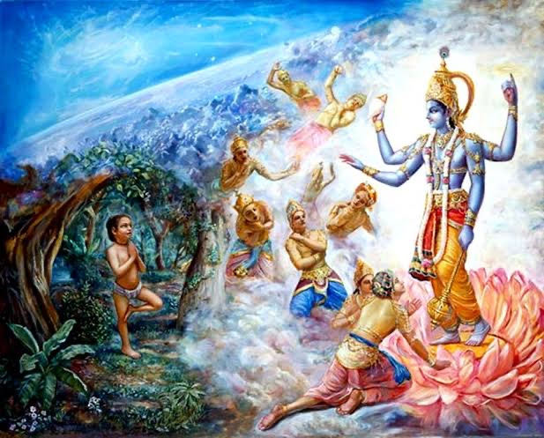
SPG: My dear demigods, do not be perturbed by this. It is due to the severe austerity and full determination of the son of King Uttānapāda, who is now fully absorbed in thought of Me. He has obstructed the universal breathing process. You can safely return to your respective homes. I shall stop this boy in his severe acts of austerities, and you will be saved from this situation [SB 4.8.82]

Slide 7
SB 4.8.17: Wish good to all
दीर्घं श्वसन्ती वृजिनस्य पार- मपश्यती बालकमाह बाला । मामङ्गलं तात परेषु मंस्था भुङ्क्ते जनो यत्परदु:खदस्तत् ॥ १७ ॥
dīrghaṁ śvasantī vṛjinasya pāram apaśyatī bālakam āha bālā māmaṅgalaṁ tāta pareṣu maṁsthā bhuṅkte jano yat para-duḥkhadas tat
dīrgham — heavy; śvasantī — breathing; vṛjinasya — of the danger; pāram — limitation; apaśyatī — without finding; bālakam — to her son; āha — said; bālā — the lady; mā — let there not be; amaṅgalam — ill fortune; tāta — my dear son; pareṣu — unto others; maṁsthāḥ — desire; bhuṅkte — suffered; janaḥ — person; yat — that which; para-duḥkhadaḥ — who is apt to inflict pains upon others; tat — that.
She also was breathing very heavily, and she did not know the factual remedy for the painful situation. Not finding any remedy, she said to her son: My dear son, don’t wish for anything inauspicious for others. Anyone who inflicts pains upon others suffers himself from that pain.

Slide 8
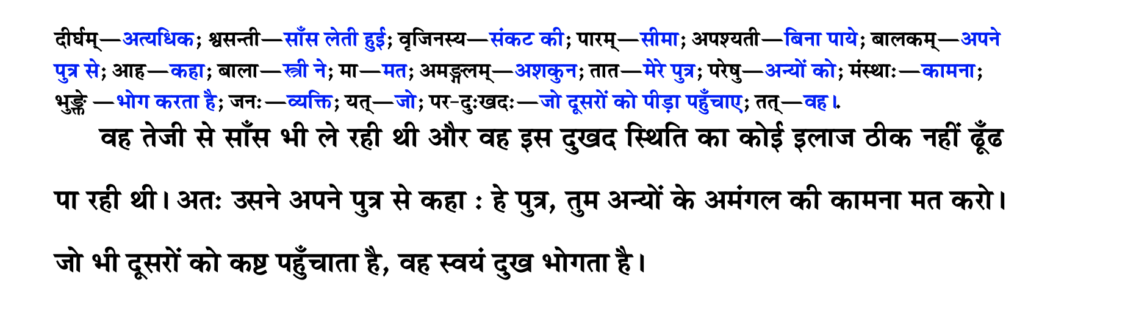

Slide 9
SB 4.8.18
सत्यं सुरुच्याभिहितं भवान्मे यद्दुर्भगाया उदरे गृहीत: । स्तन्येन वृद्धश्च विलज्जते यां भार्येति वा वोढुमिडस्पतिर्माम् ॥ १८ ॥
satyaṁ surucyābhihitaṁ bhavān me yad durbhagāyā udare gṛhītaḥ stanyena vṛddhaś ca vilajjate yāṁ bhāryeti vā voḍhum iḍaspatir mām
satyam — truth; surucyā — by Queen Suruci; abhihitam — narrated; bhavān — unto you; me — of me; yat — because; durbhagāyāḥ — of the unfortunate; udare — in the womb; gṛhītaḥ — taken birth; stanyena — fed by the breast milk; vṛddhaḥ ca — grown up; vilajjate — becomes ashamed; yām — unto one; bhāryā — wife; iti — thus; vā — or; voḍhum — to accept; iḍaḥ-patiḥ — the King; mām — me.
Sunīti said: My dear boy, whatever has been spoken by Suruci is so, because the King, your father, does not consider me his wife or even his maidservant. He feels ashamed to accept me. Therefore it is a fact that you have taken birth from the womb of an unfortunate woman, and by being fed from her breast you have grown up.

Slide 10
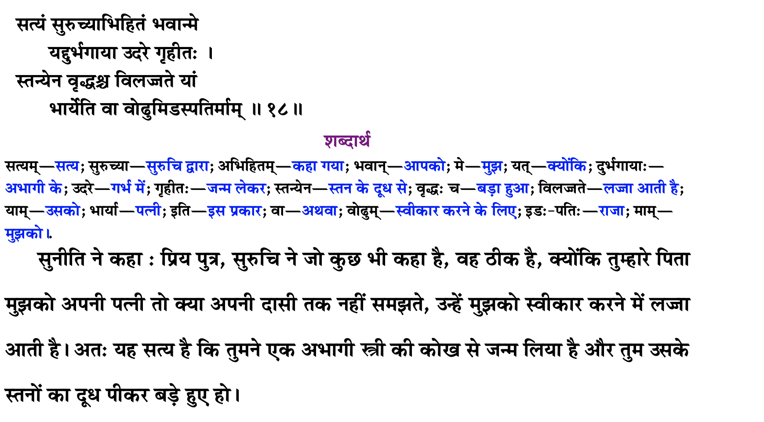

Slide 11
SB 4.8.19
My dear boy, whatever has been spoken by Suruci, your stepmother, although very harsh to hear, is factual. Therefore, if you desire at all to sit on the same throne as your stepbrother, Uttama, then give up your envious attitude and immediately try to execute the instructions of your stepmother. Without further delay, you must engage yourself in worshiping the lotus feet of the Supreme Personality of Godhead.
The harsh words used by Suruci to her stepson were true because unless one is favored by the Supreme Personality of Godhead one cannot achieve any success in life. Man proposes, God disposes. Sunīti, the mother of Dhruva Mahārāja, agreed with her co-wife’s advice that Dhruva engage himself in the worship of the Supreme Personality of Godhead. Indirectly, the words of Suruci were a benediction for Dhruva Mahārāja, for because of the influence of his stepmother’s words, he became a great devotee.

Slide 12
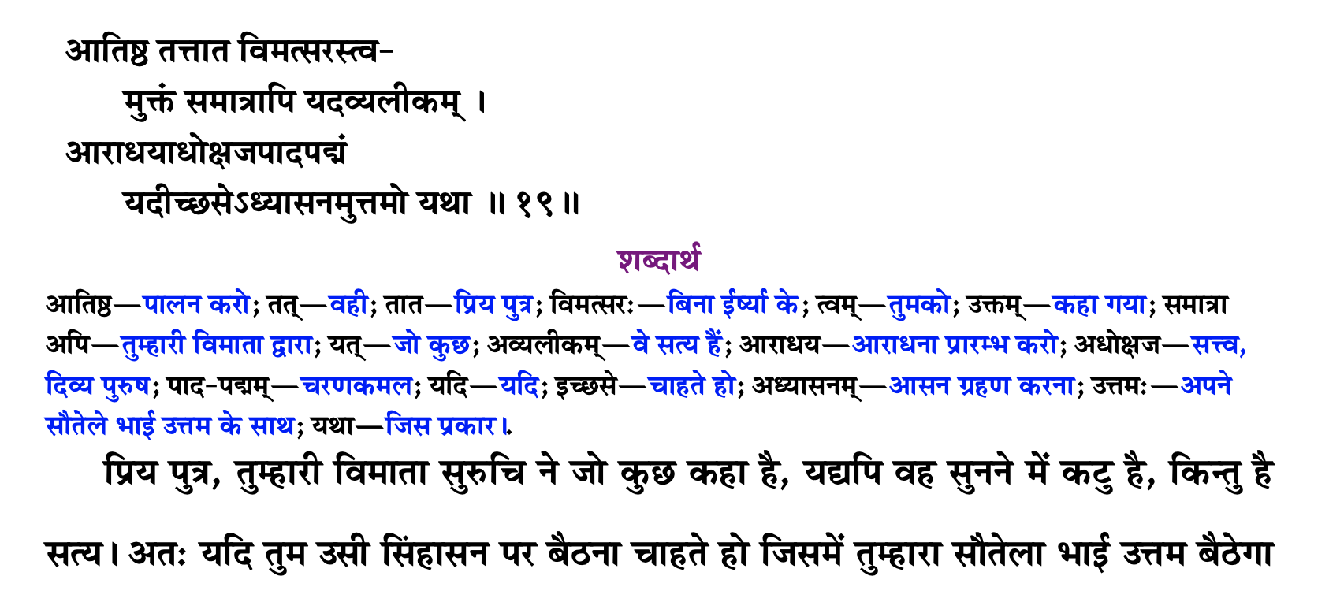
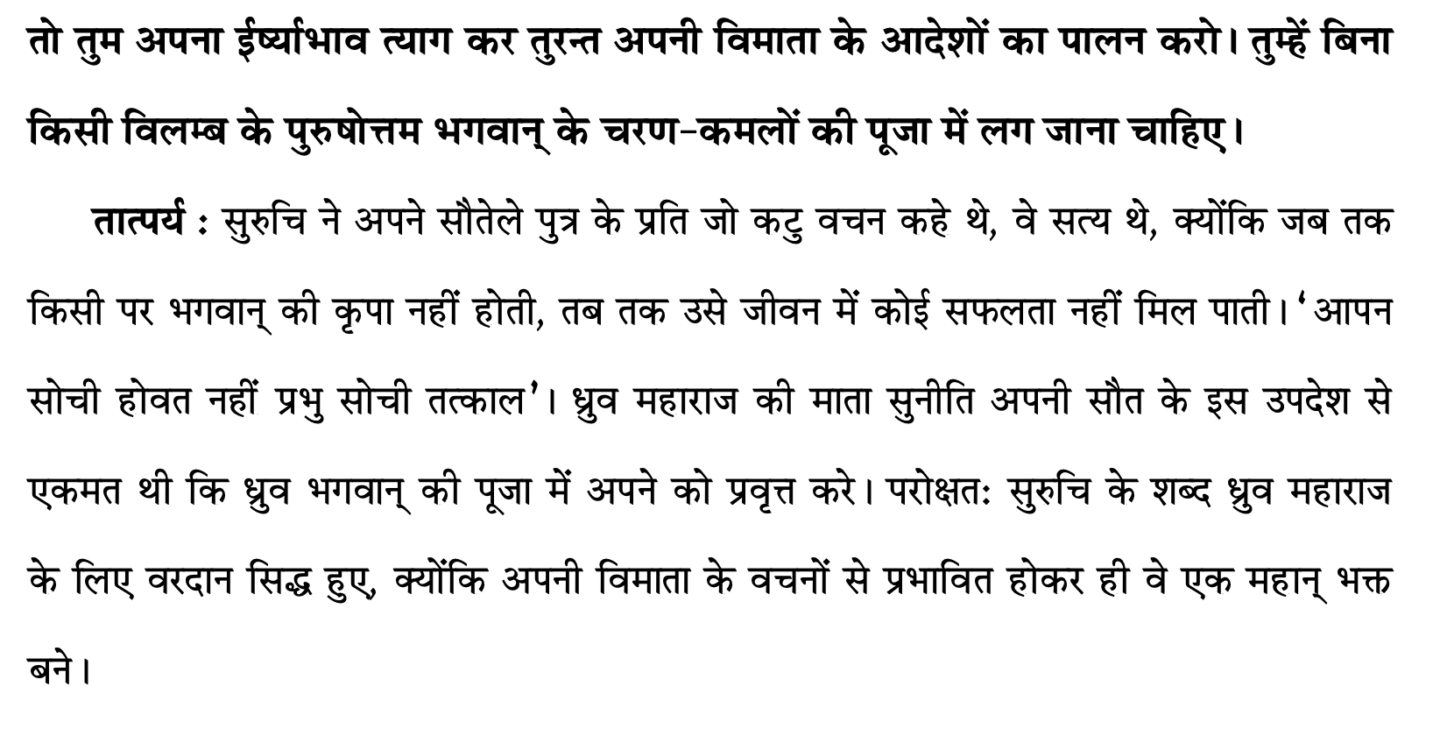


Slide 13
SB 4.8.20-21: Lord is Great – worship Him
Sunīti continued: The Supreme Personality of Godhead is so great that simply by worshiping His lotus feet, your great-grandfather, Lord Brahmā, acquired the necessary qualifications to create this universe. Although he is unborn and is the chief of all living creatures, he is situated in that exalted post because of the mercy of the Supreme Personality of Godhead, whom even great yogīs worship by controlling the mind and regulating the life air [prāṇa].
Sunīti informed her son: Your grandfather Svāyambhuva Manu executed great sacrifices with distribution of charity, and thereby, with unflinching faith and devotion, he worshiped and satisfied the Supreme Personality of Godhead. By acting in that way, he achieved the greatest success in material happiness and afterwards achieved liberation, which is impossible to obtain by worshiping the demigods.

Slide 14
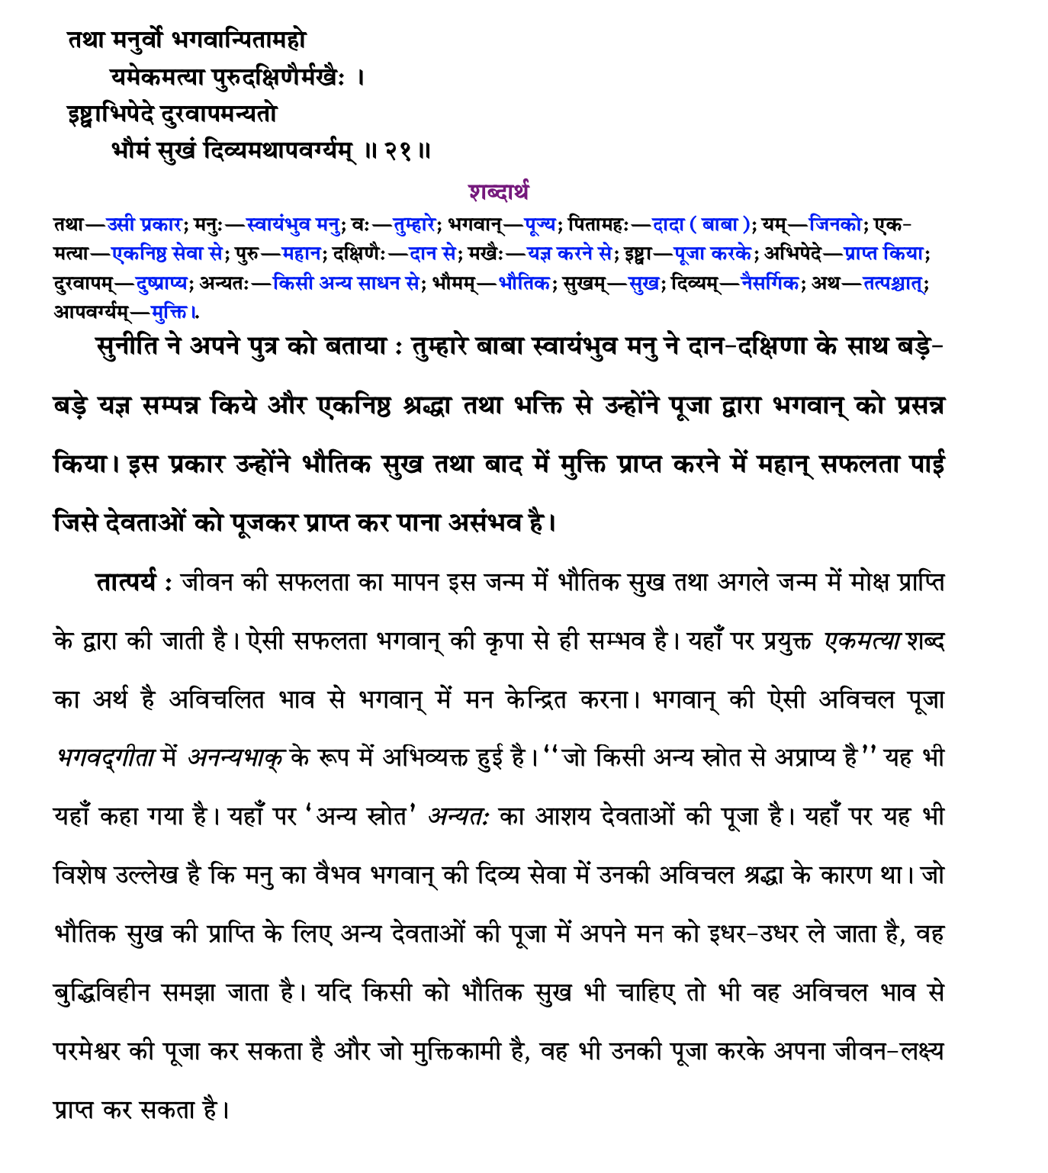

Slide 15
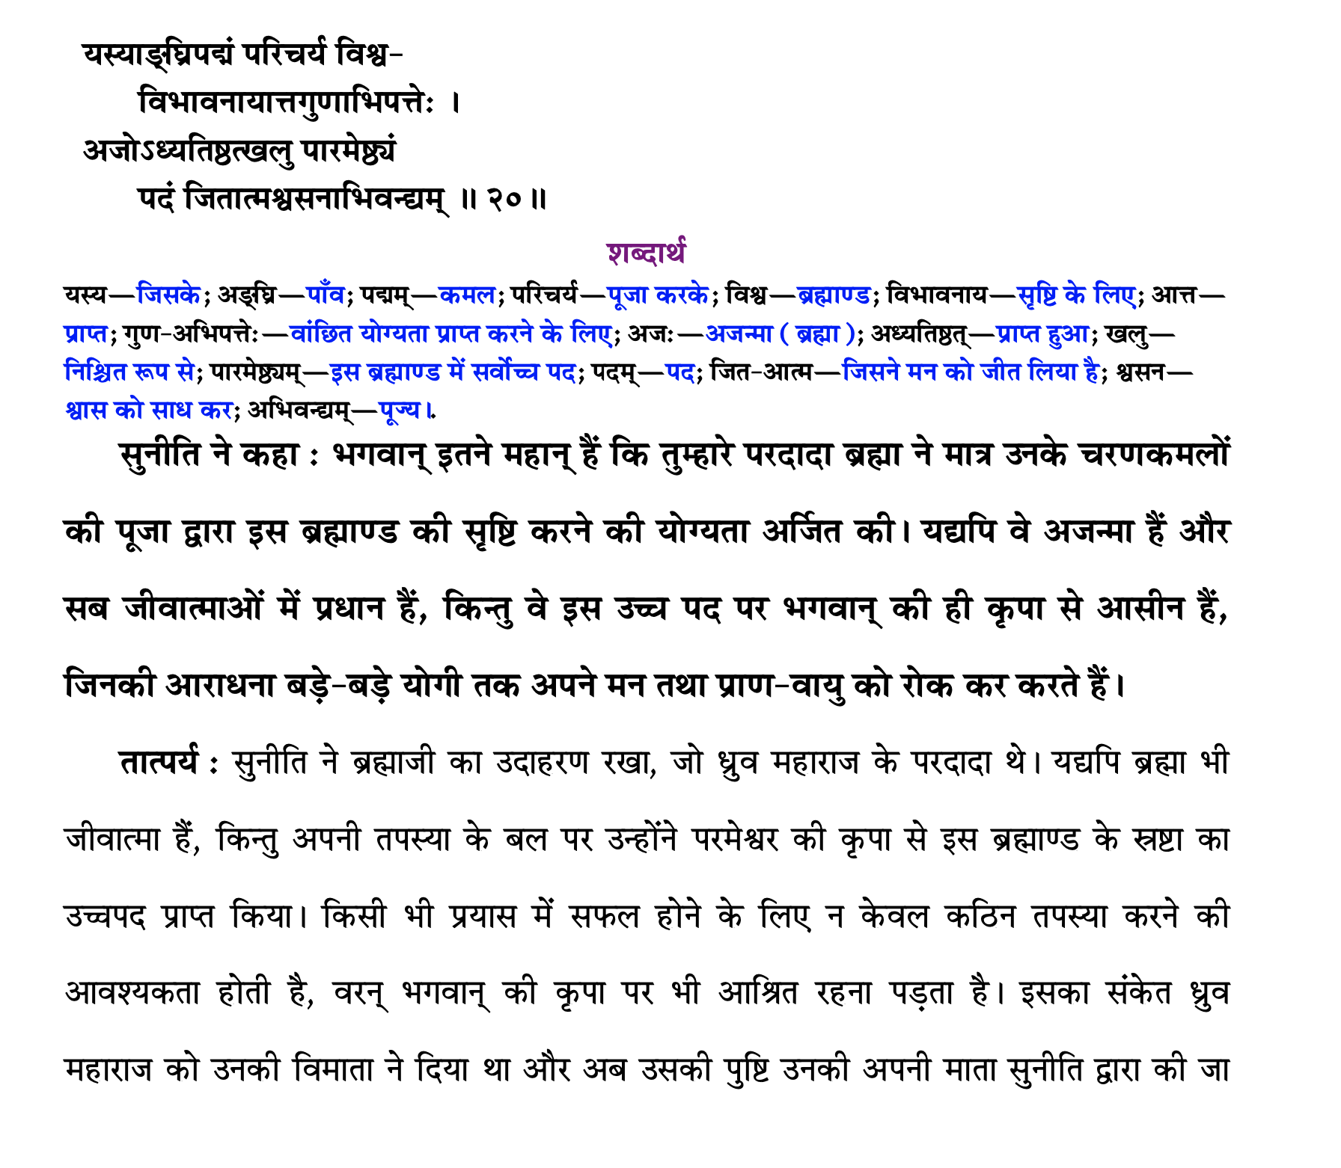

Slide 16
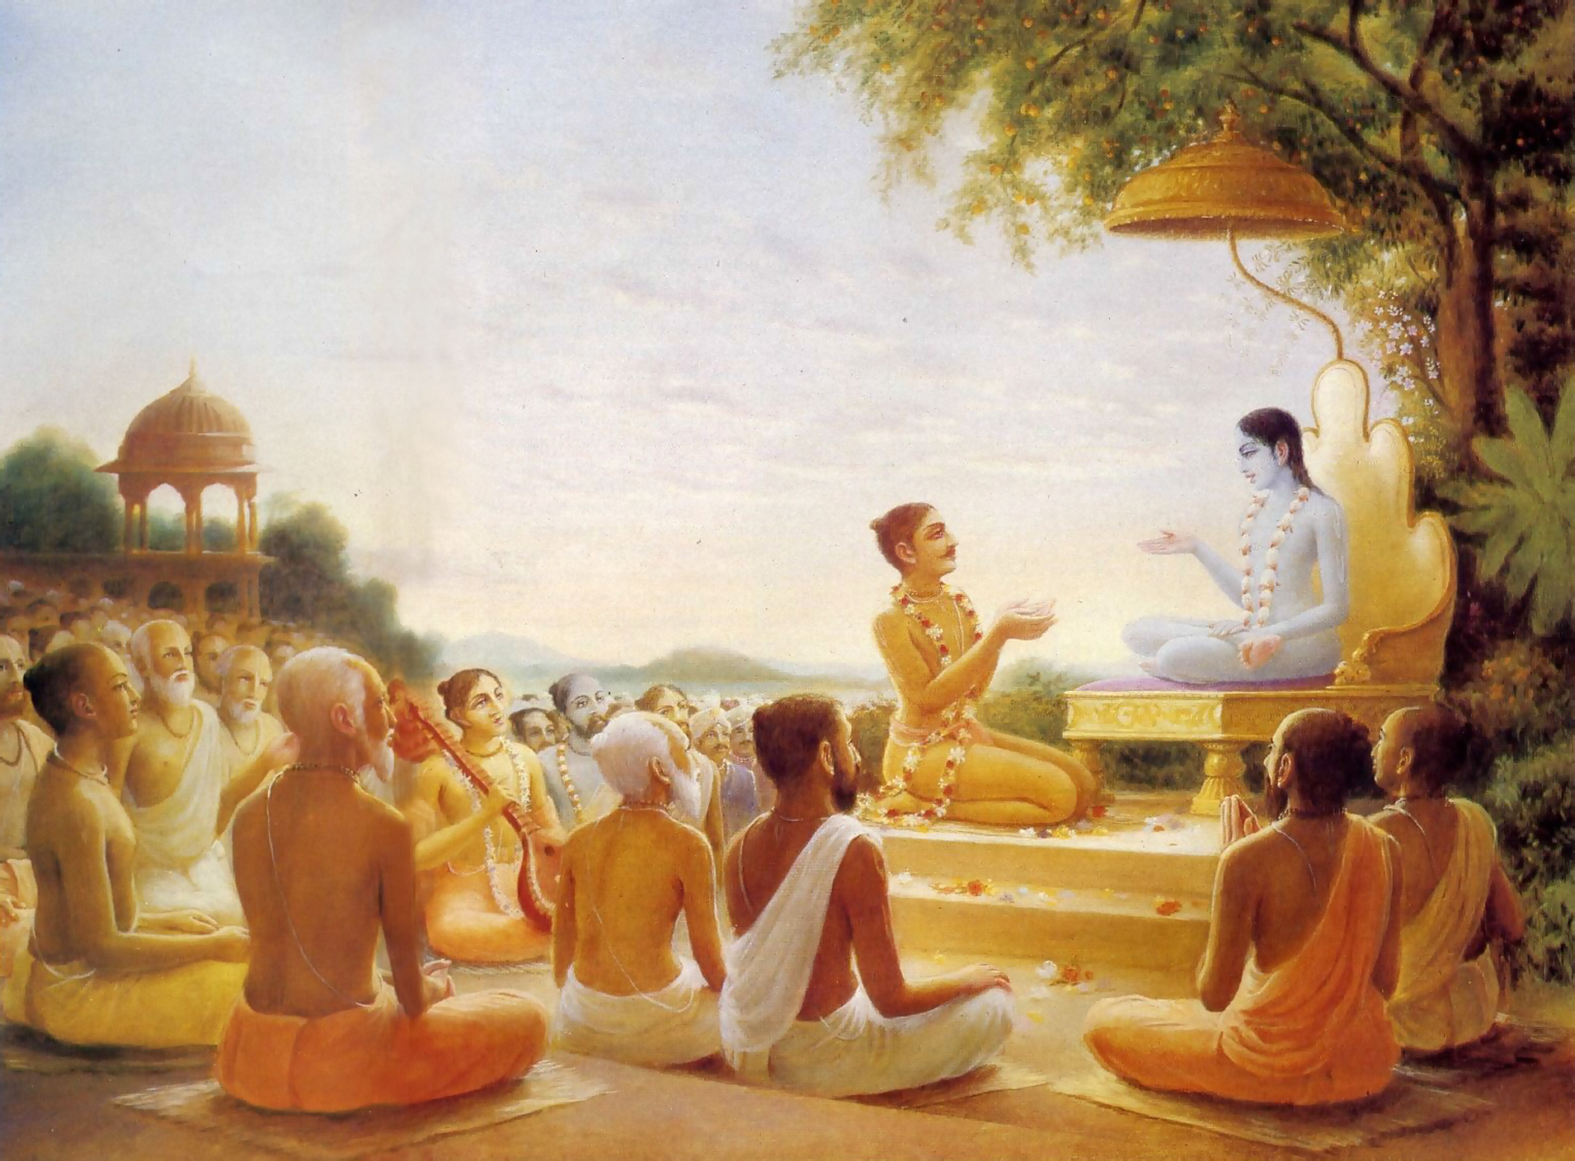
We have to go!
पुनश्च भूयाद्भगवत्यनन्ते
रति: प्रसङ्गश्च तदाश्रयेषु । महत्सु यां यामुपयामि सृष्टिं
मैत्र्यस्तु सर्वत्र नमो द्विजेभ्य: ॥ १६ ॥
punaś ca bhūyād bhagavaty anante
ratiḥ prasaṅgaś ca tad-āśrayeṣu mahatsu yāṁ yām upayāmi sṛṣṭiṁ
maitry astu sarvatra namo dvijebhyaḥ
Again, offering obeisances unto all you brāhmaṇas, I pray that if I should again take my birth in the material world I will have complete attachment to the unlimited Lord Kṛṣṇa, association with His devotees and friendly relations with all living beings. [SB 1.19.16]

Slide 17
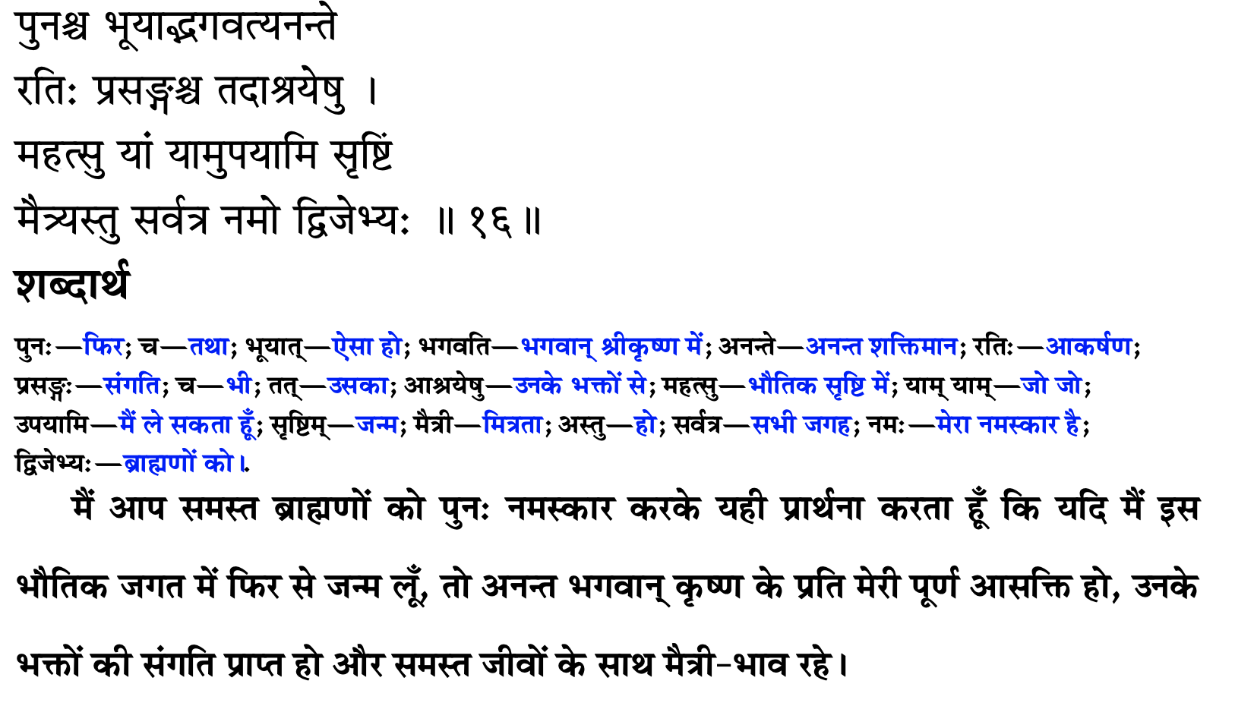
हमने जाना है

Slide 18
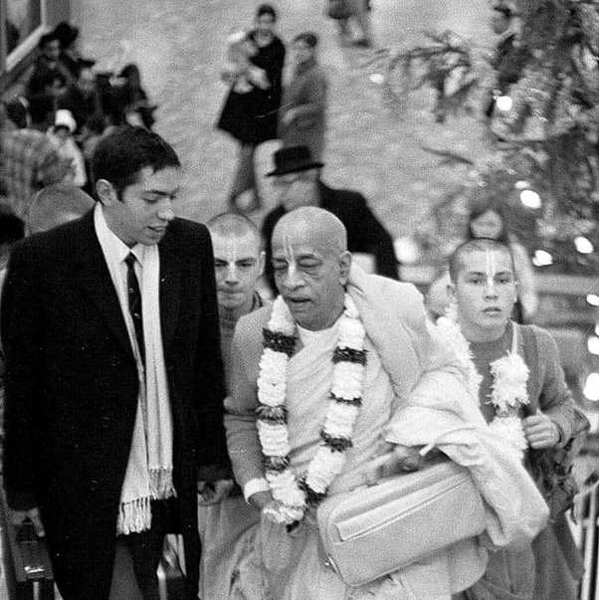
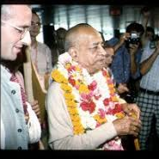
Blame yourself not others – See only Krishna
बहूनां जन्मनामन्ते ज्ञानवान्मां प्रपद्यते । वासुदेव: सर्वमिति स महात्मा सुदुर्लभ: ॥ १९ ॥
bahūnāṁ janmanām ante jñānavān māṁ prapadyate vāsudevaḥ sarvam iti sa mahātmā su-durlabhaḥ
bahūnām — many; janmanām — repeated births and deaths; ante — after; jñāna-vān — one who is in full knowledge; mām — unto Me; prapadyate — surrenders; vāsudevaḥ — the Personality of Godhead, Kṛṣṇa; sarvam — everything; iti — thus; saḥ — that; mahā-ātmā — great soul; su-durlabhaḥ — very rare to see.
After many births and deaths, he who is actually in knowledge surrenders unto Me, knowing Me to be the cause of all causes and all that is. Such a great soul is very rare.[BG 7.19]

Slide 19
Points to remember
Source of all good qualities is ………
Where there is ……… all good qualities reside
Real doer is ……..
Everything happens according to …….. plans.
If we develop habit of seeing ……. in all circumstances, then we will not have …….. towards anybody.
Blame …….. not others

Slide 20
कृपया याद रखें
सभी अच्छे गुणों का स्रोत ……. है
जहां ……. हैं वहां सभी अच्छे गुण निवास करते हैं
असली कर्ता ……. है
सब कुछ ……. की योजना के अनुसार होता है
यदि हम सभी परिस्थितियों में ……. को देखने की आदत विकसित करेंगे तो हम किसी के प्रति …….. नहीं करेंगे.
……. को दोष दें दूसरों को नहीं

Slide 21
Eat sparingly and depend on Krishna
One who eats sparingly, eats away the sorrows.
If something happens to the body, then first thing you do is to shut our mouth.
Firstly, don’t talk much or get angry at anyone.
When you are not the cause, then why are you angry?
Not a leaf can move without His permission.

Slide 22
संयमपूर्वक भोजन करें और कृष्ण पर निर्भर रहें
जो कम खाता है, वे गम खाता है
अगर शरीर शरीर बीमार हो, तो सबसे पहले आप अपना मुंह बंद करें।
सबसे पहले, ज्यादा बात न करें या किसी पर गुस्सा न करें।
जब आप कारण नहीं हैं, तो आप नाराज क्यों हैं?
एक पत्ता भी उनकी अनुमति के बिना नहीं हिल सकता

Slide 23
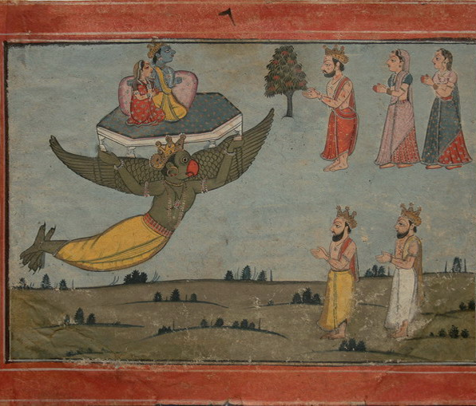
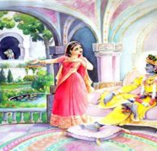
Determination
Any person who observes regulative principles and fulfills his promises by practical activity is called determined.
They must be conscious of the difference between their present conditions and their past conditions and should always be very careful not to fall from the most exalted life of Kṛṣṇa consciousness. Every devotee of Kṛṣṇa should have this determination.
Indra was forcibly deprived of the pārijāta flower

Slide 24
दृढ़ निश्चय
कोई भी व्यक्ति जो नियामक सिद्धांतों का पालन करता है और व्यावहारिक गतिविधियों द्वारा अपने वादों को पूरा करता है, उसे दृढ़ निश्चय कहा जाता है।
उन्हें अपनी वर्तमान स्थितियों और अपनी पिछली स्थितियों के बीच के अंतर के बारे में सचेत रहना चाहिए और हमेशा इस बात का ध्यान रखना चाहिए कि कृष्ण चेतना के सबसे ऊंचे जीवन से न गिरें। कृष्ण के प्रत्येक भक्त का यह दृढ़ संकल्प होना चाहिए।
इंद्र को जबरन पुष्पराज से वंचित किया गया

Slide 25
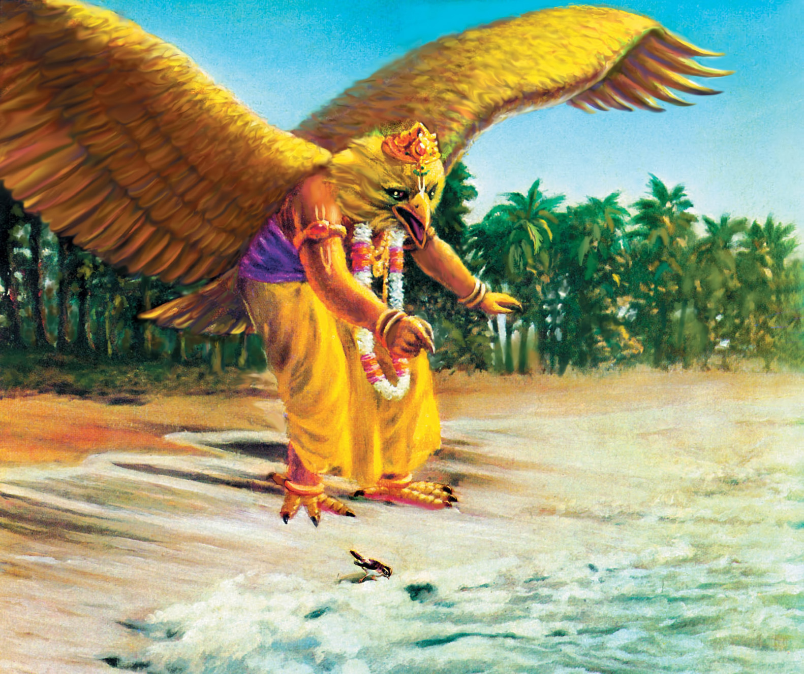

Slide 26
Bg. 18.33
धृत्या यया धारयते मन:प्राणेन्द्रियक्रिया: । योगेनाव्यभिचारिण्या धृति: सा पार्थ सात्त्विकी ॥ ३३ ॥
dhṛtyā yayā dhārayate manaḥ-prāṇendriya-kriyāḥ yogenāvyabhicāriṇyā dhṛtiḥ sā pārtha sāttvikī
Synonyms
dhṛtyā — determination; yayā — by which; dhārayate — one sustains; manaḥ — of the mind; prāṇa — life; indriya — and senses; kriyāḥ — the activities; yogena — by yoga practice; avyabhicāriṇyā — without any break; dhṛtiḥ — determination; sā — that; pārtha — O son of Pṛthā; sāttvikī — in the mode of goodness.
Translation
O son of Pṛthā, that determination which is unbreakable, which is sustained with steadfastness by yoga practice, and which thus controls the activities of the mind, life and senses is determination in the mode of goodness.
Purport
Yoga is a means to understand the Supreme Soul. One who is steadily fixed in the Supreme Soul with determination, concentrating one’s mind, life and sensory activities on the Supreme, engages in Kṛṣṇa consciousness. That sort of determination is in the mode of goodness. The word avyabhicāriṇyā is very significant, for it indicates that persons who are engaged in Kṛṣṇa consciousness are never deviated by any other activity.

Slide 27
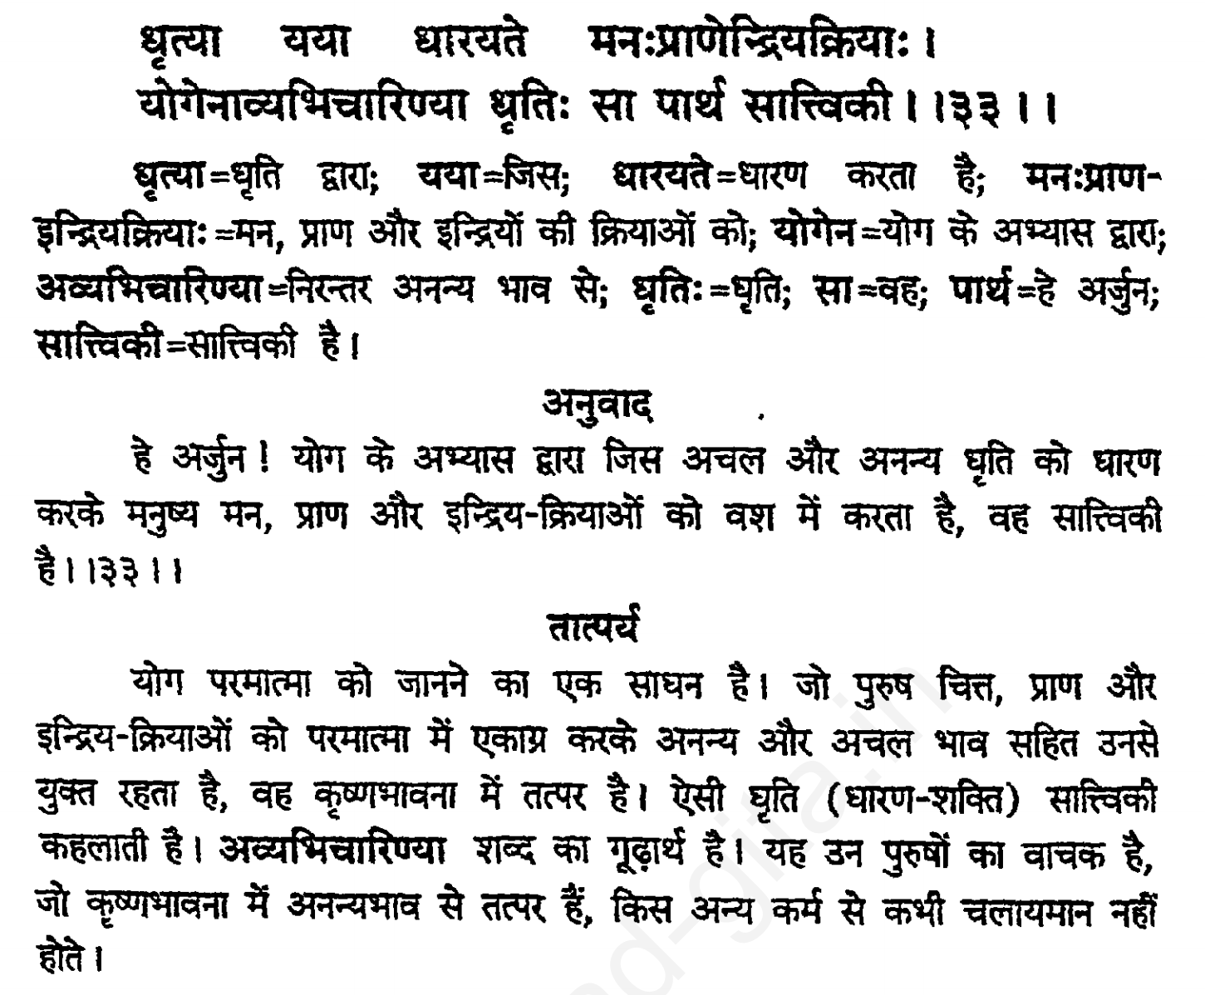

Slide 28
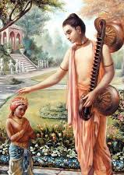
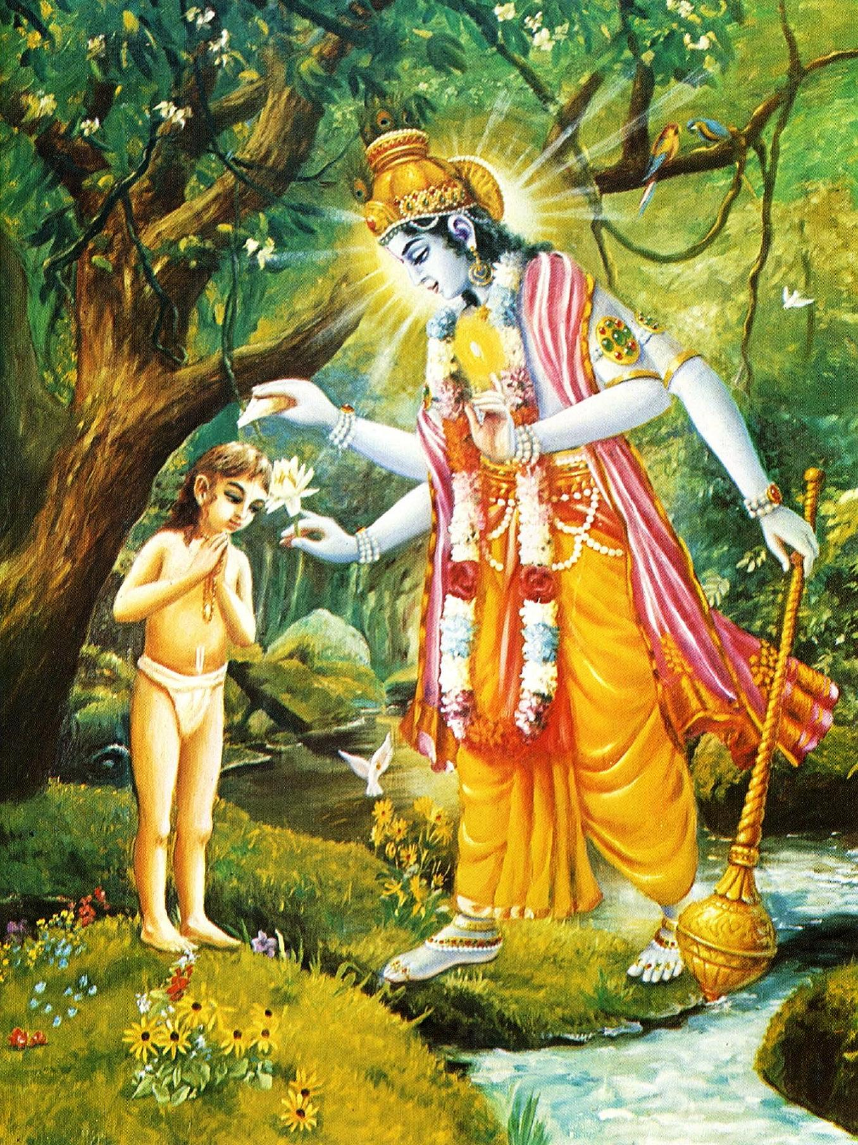
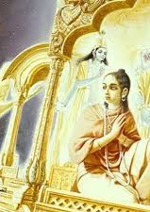
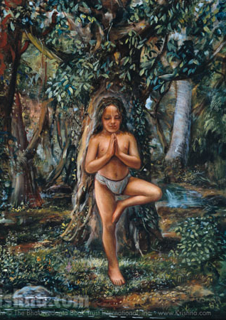
ध्रुव महाराज

Slide 29

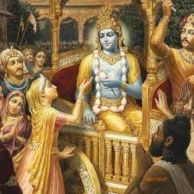
Prayers of Mother Kunti [1.8.18-22]
kunty uvāca namasye puruṣaṁ tvādyam īśvaraṁ prakṛteḥ param alakṣyaṁ sarva-bhūtānām antar bahir avasthitam
māyā-javanikācchannam ajñādhokṣajam avyayam na lakṣyase mūḍha-dṛśā naṭo nāṭyadharo yathā
tathā paramahaṁsānāṁ munīnām amalātmanām bhakti-yoga-vidhānārthaṁ kathaṁ paśyema hi striyaḥ
kṛṣṇāya vāsudevāya devakī-nandanāya ca nanda-gopa-kumārāya govindāya namo namaḥ
namaḥ paṅkaja-nābhāya namaḥ paṅkaja-māline namaḥ paṅkaja-netrāya namas te paṅkajāṅghraye

Slide 30
Prayers of Mother Kunti
कुन्त्युवाच नमस्ये पुरुषं त्वाद्यमीश्वरं प्रकृते: परम् । अलक्ष्यं सर्वभूतानामन्तर्बहिरवस्थितम् ॥ १८ ॥
मायाजवनिकाच्छन्नमज्ञाधोक्षजमव्ययम् । न लक्ष्यसे मूढद‍ृशा नटो नाट्यधरो यथा ॥ १९ ॥
तथा परमहंसानां मुनीनाममलात्मनाम् । भक्तियोगविधानार्थं कथं पश्येम हि स्त्रिय: ॥ २० ॥
कृष्णाय वासुदेवाय देवकीनन्दनाय च । नन्दगोपकुमाराय गोविन्दाय नमो नम: ॥ २१ ॥
नम: पङ्कजनाभाय नम: पङ्कजमालिने । नम: पङ्कजनेत्राय नमस्ते पङ्कजाङ्‍घ्रये ॥ २२ ॥

Slide 31
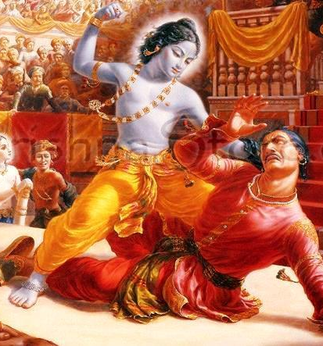
SB 1.8.23
यथा हृषीकेश खलेन देवकी कंसेन रुद्धातिचिरं शुचार्पिता । विमोचिताहं च सहात्मजा विभो त्वयैव नाथेन मुहुर्विपद्गणात् ॥ २३ ॥
O Hṛṣīkeśa, master of the senses and Lord of lords, You have released Your mother, Devakī, who was long imprisoned and distressed by the envious King Kaṁsa, and me and my children from a series of constant dangers.

Slide 32
yathā hṛṣīkeśa khalena devakī kaṁsena ruddhāticiraṁ śucārpitā vimocitāhaṁ ca sahātmajā vibho tvayaiva nāthena muhur vipad-gaṇāt
yathā — as it were; hṛṣīkeśa — the master of the senses; khalena — by the envious; devakī — Devakī (the mother of Śrī Kṛṣṇa); kaṁsena — by King Kaṁsa; ruddhā — imprisoned; ati-ciram — for a long time; śuca-arpitā — distressed; vimocitā — released; aham ca — also myself; saha-ātma-jā — along with my children; vibho — O great one; tvayā eva — by Your Lordship; nāthena — as the protector; muhuḥ — constantly; vipat-gaṇāt — from a series of dangers.
O Hṛṣīkeśa, master of the senses and Lord of lords, You have released Your mother, Devakī, who was long imprisoned and distressed by the envious King Kaṁsa, and me and my children from a series of constant dangers.
Sometimes He puts His pure devotees in such dangers because in that condition of helplessness the devotee becomes more attached to the Lord. The more the attachment is there for the Lord, the more success is there for the devotee.

Slide 33
Types of Determination
BG 18.33: O son of Pṛthā, that determination which is unbreakable, which is sustained with steadfastness by yoga practice, and which thus controls the activities of the mind, life and senses is determination in the mode of goodness.
BG 18.34: But that determination by which one holds fast to fruitive results in religion, economic development and sense gratification is of the nature of passion, O Arjuna.
BG 18.35: And that determination which cannot go beyond dreaming, fearfulness, lamentation, moroseness and illusion – such unintelligent determination, O son of Pṛthā, is in the mode of darkness.

Slide 34
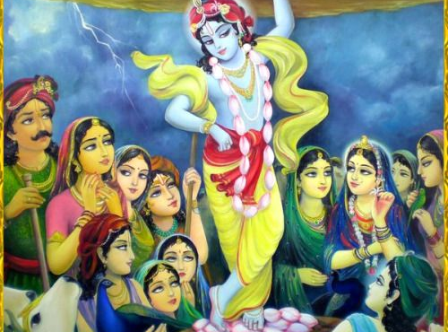

Slide 35
Prayer unto lotus feet of Gurudeva
Learn to tolerance and patience
Invest saved time in pages of Bhagavatam
Be reservoir of good qualities
leads to happiness
See the hand of Krishna in everything
free from anger and envy
Be determined
Perform sadhana and be careful of devotional asset
I have to go
be attached to Lord, guru lotus feet and devotees

Slide 36
प्रार्थना - गुरुदेव के चरण कमल
सहनशीलता और धैर्य सीखें
भागवतम के पन्नों में निवेश से बचा हुआ समय
अच्छे गुणों का भंडार हो
खुशियों की ओर ले जाता है
हर चीज में कृष्ण का हाथ देखें
क्रोध और ईर्ष्या से मुक्त
दृढ़ निश्चयी रहें
साधना करें और भक्ति संपत्ति से सावधान रहें
मुझे जाना होगा
भगवान, गुरु के चरण कमल और भक्तों से जुड़े रहें

Slide 37
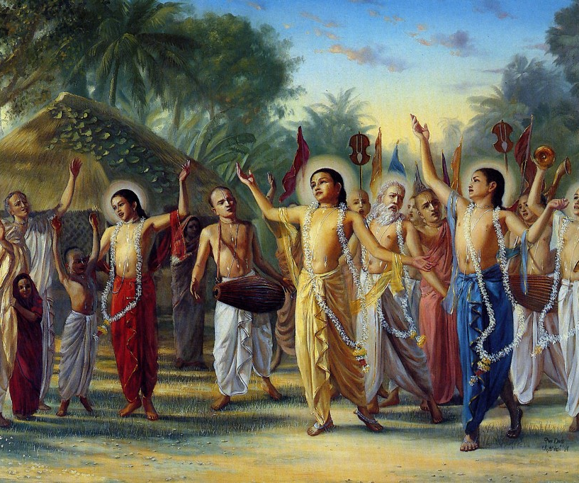
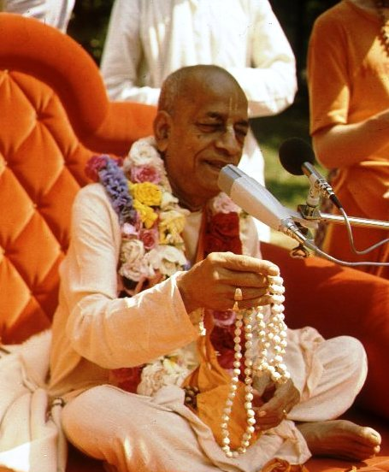
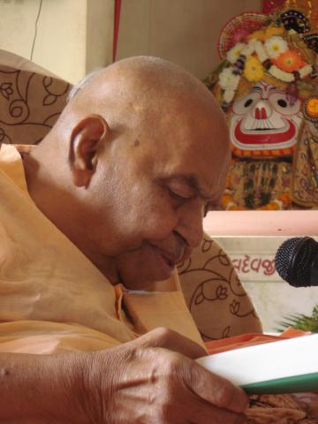
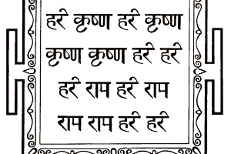
हरे कृष्णा
श्रील प्रभुपाद की जय
गुरुदेव की जय

